Slide 1




Carbon Dioxide Capture in Spacecraft Using Novel Microsphere-loaded Polymers
Cameron Morgan
Associate Professor Matthew Green
School for Engineering of Matter, Transport & Energy
Mentors: Ani Nazari & Kacie Niimoto
NASA Space Grant Symposium 2023

Slide 2

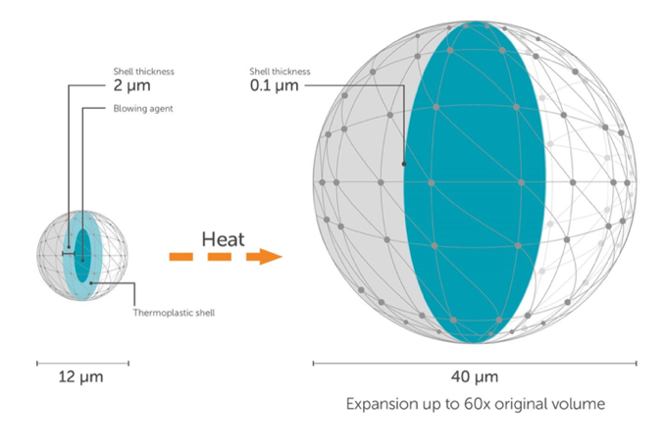
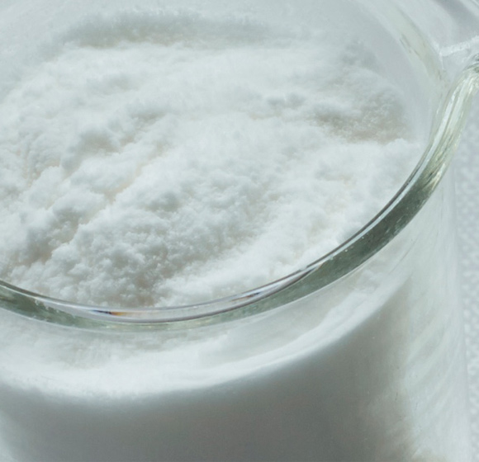
Motivation
Problems
Elevated CO₂ levels lead to adverse health affects
Zeolite issues: dusting and water uptake
High temperature regeneration, which is not energy efficient
Necessary requirements: high efficiency, low energy usage, high structural strength, no dusting with water
Research Question
How does the addition of Expancel microspheres impact a polymer designed for CO₂ capture, using a humidity-swing system?
Addition of the spheres likely increases the available active sites for CO₂ capture
Expand until rupture – makes porous foam structure
Expanded spheres, increase surface area
Dry Unexpanded (DU) vs Dry Expanded (DE) Microspheres
Figure 1: Microsphere expansion graphic from Nouryon.
Figure 2: Dry microspheres image from Nouryon.
1
Motivation Synthesis & Results CO₂ Testing Energy Efficiency Conclusions & Future Work

Slide 3
Motivation
Problems
Elevated CO₂ levels lead to adverse health affects
Zeolite issues: dusting and water uptake
High temperature regeneration, which is not energy efficient
Necessary requirements: high efficiency, low energy usage, high structural strength, no dusting with water
Research Question
How does the addition of Expancel microspheres impact a polymer designed for CO₂ capture, using a humidity-swing system?
Addition of the spheres likely increases the available active sites for CO₂ capture
Expand until rupture – makes porous foam structure
Expanded spheres, increase surface area
Dry Unexpanded (DU) vs Dry Expanded (DE) Microspheres
Figure 1: Microsphere expansion graphic from Nouryon.
Figure 2: Dry microspheres image from Nouryon.
1
Motivation Synthesis & Results CO₂ Testing Energy Efficiency Conclusions & Future Work

Slide 4
Motivation
Problems
Elevated CO₂ levels lead to adverse health affects
Zeolite issues: dusting and water uptake
High temperature regeneration, which is not energy efficient
Necessary requirements: high efficiency, low energy usage, high structural strength, no dusting with water
Research Question
How does the addition of Expancel microspheres impact a polymer designed for CO₂ capture, using a humidity-swing system?
Addition of the spheres likely increases the available active sites for CO₂ capture
Expand until rupture – makes porous foam structure
Expanded spheres, increase surface area
Dry Unexpanded (DU) vs Dry Expanded (DE) Microspheres
Figure 1: Microsphere expansion graphic from Nouryon.
Figure 2: Dry microspheres image from Nouryon.
1
Motivation Synthesis & Results CO₂ Testing Energy Efficiency Conclusions & Future Work

Slide 5
Motivation
Problems
Elevated CO₂ levels lead to adverse health affects
Zeolite issues: dusting and water uptake
High temperature regeneration, which is not energy efficient
Necessary requirements: high efficiency, low energy usage, high structural strength, no dusting with water
Research Question
How does the addition of Expancel microspheres impact a polymer designed for CO₂ capture, using a humidity-swing system?
Addition of the spheres likely increases the available active sites for CO₂ capture
Expand until rupture – makes porous foam structure
Expanded spheres, increase surface area
Dry Unexpanded (DU) vs Dry Expanded (DE) Microspheres
Figure 1: Microsphere expansion graphic from Nouryon.
Figure 2: Dry microspheres image from Nouryon.
1
Motivation Synthesis & Results CO₂ Testing Energy Efficiency Conclusions & Future Work

Slide 6
Motivation
Problems
Elevated CO₂ levels lead to adverse health affects
Zeolite issues: dusting and water uptake
High temperature regeneration, which is not energy efficient
Necessary requirements: high efficiency, low energy usage, high structural strength, no dusting with water
Research Question
How does the addition of Expancel microspheres impact a polymer designed for CO₂ capture, using a humidity-swing system?
Addition of the spheres likely increases the available active sites for CO₂ capture
Expand until rupture – makes porous foam structure
Expanded spheres, increase surface area
Dry Unexpanded (DU) vs Dry Expanded (DE) Microspheres
Figure 1: Microsphere expansion graphic from Nouryon.
Figure 2: Dry microspheres image from Nouryon.
1
Motivation Synthesis & Results CO₂ Testing Energy Efficiency Conclusions & Future Work

Slide 7
Motivation
Problems
Elevated CO₂ levels lead to adverse health affects
Zeolite issues: dusting and water uptake
High temperature regeneration, which is not energy efficient
Necessary requirements: high efficiency, low energy usage, high structural strength, no dusting with water
Research Question
How does the addition of Expancel microspheres impact a polymer designed for CO₂ capture, using a humidity-swing system?
Addition of the spheres likely increases the available active sites for CO₂ capture
Expand until rupture – makes porous foam structure
Expanded spheres, increase surface area
Dry Unexpanded (DU) vs Dry Expanded (DE) Microspheres
Figure 1: Microsphere expansion graphic from Nouryon.
Figure 2: Dry microspheres image from Nouryon.
1
Motivation Synthesis & Results CO₂ Testing Energy Efficiency Conclusions & Future Work

Slide 8
Motivation
Problems
Elevated CO₂ levels lead to adverse health affects
Zeolite issues: dusting and water uptake
High temperature regeneration, which is not energy efficient
Necessary requirements: high efficiency, low energy usage, high structural strength, no dusting with water
Research Question
How does the addition of Expancel microspheres impact a polymer designed for CO₂ capture, using a humidity-swing system?
Addition of the spheres likely increases the available active sites for CO₂ capture
Expand until rupture – makes porous foam structure
Expanded spheres, increase surface area
Dry Unexpanded (DU) vs Dry Expanded (DE) Microspheres
Figure 1: Microsphere expansion graphic from Nouryon.
Figure 2: Dry microspheres image from Nouryon.
1
Motivation Synthesis & Results CO₂ Testing Energy Efficiency Conclusions & Future Work

Slide 9
Synthesis & Results
Objective
Increase surface area to increase the number of available active capture sites
Method 1
Expanding Unexpanded Microspheres
Method 2
Using Pre-expanded Microspheres
Add heat
v
v
Surface Area (Unexpanded) < Surface Area (Expanded)
SEM image of control without microspheres
(400 µm scale, 100x magnification)
SEM image of 1 % (w/w) dry expanded microspheres
(500 µm scale, 80x magnification)
2
Motivation Synthesis & Results CO₂ Testing Energy Efficiency Conclusions & Future Work

Slide 10
Synthesis & Results
Objective
Increase surface area to increase the number of available active capture sites
Method 1
Expanding Unexpanded Microspheres
Method 2
Using Pre-expanded Microspheres
Add heat
v
v
Surface Area (Unexpanded) < Surface Area (Expanded)
SEM image of control without microspheres
(400 µm scale, 100x magnification)
SEM image of 1 % (w/w) dry expanded microspheres
(500 µm scale, 80x magnification)
UV
Stir bar mixing
Vial polymerization
2
Motivation Synthesis & Results CO₂ Testing Energy Efficiency Conclusions & Future Work

Slide 11
Synthesis & Results
Objective
Increase surface area to increase the number of available active capture sites
Method 1
Expanding Unexpanded Microspheres
Method 2
Using Pre-expanded Microspheres
Add heat
v
v
Surface Area (Unexpanded) < Surface Area (Expanded)
UV
SEM image of control without microspheres
(400 µm scale, 100x magnification)
SEM image of 1 % (w/w) dry expanded microspheres
(500 µm scale, 80x magnification)
UV
Stir bar mixing
Vial polymerization
Silicon mold polymerization
2
Motivation Synthesis & Results CO₂ Testing Energy Efficiency Conclusions & Future Work

Slide 12
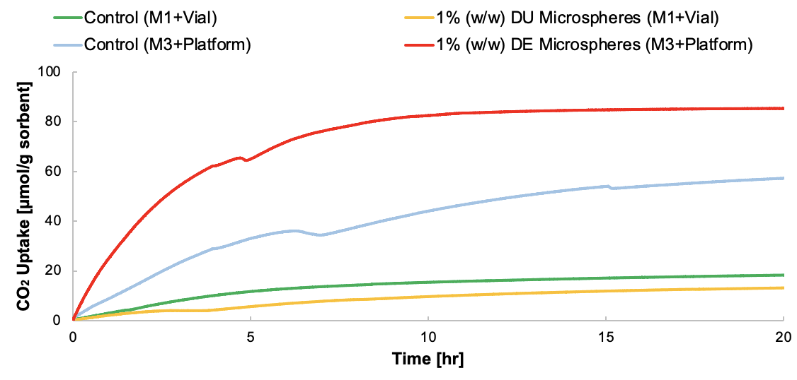
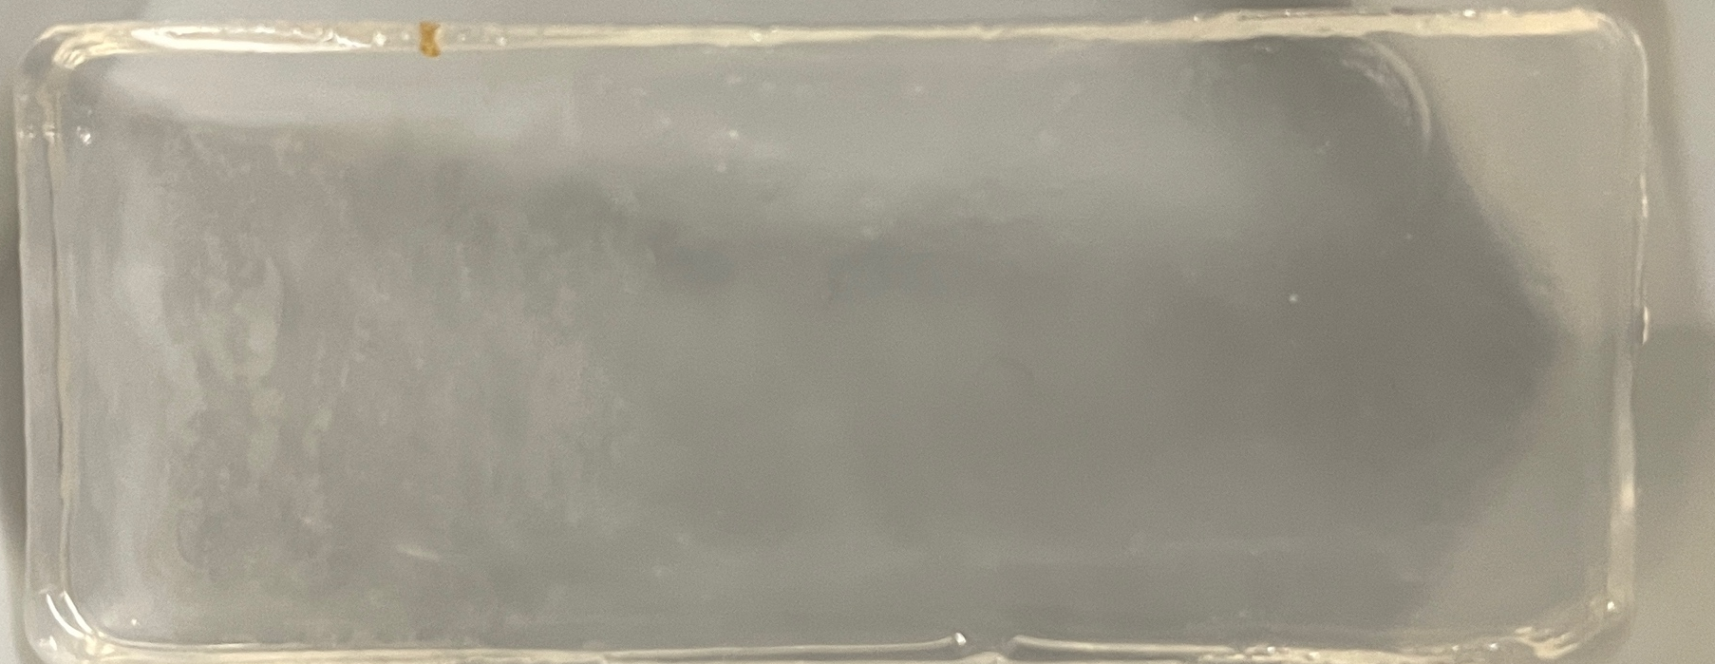
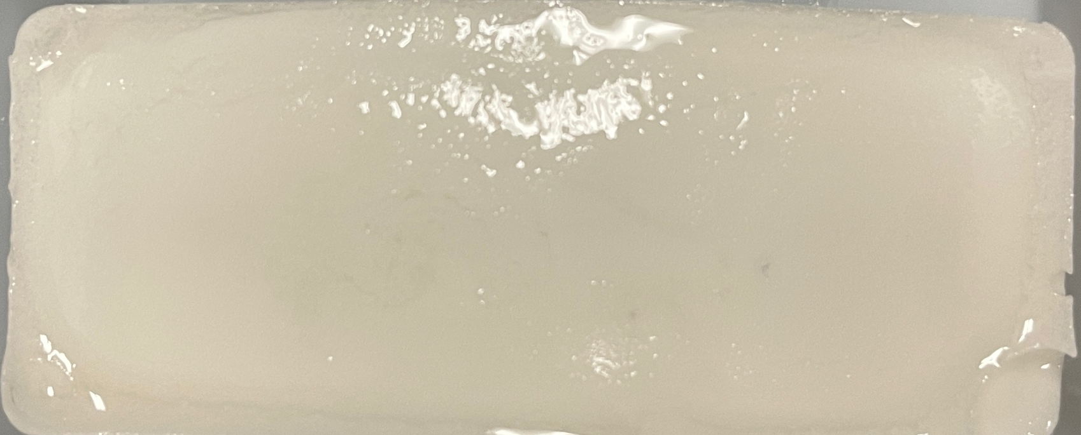
CO₂ Testing
Sample | CO₂ Uptake at 20 Hours (µmol/g) | CO₂ Uptake Kinetics (first 5 hours) (µmol/g*hr⁻¹) | Bicarbonate Exchange (1 soak)
1% (w/w) DE Microspheres (Si mold) | 85.4 | 13.0 | 75.9%
Control (Si Mold) | 57.3 | 6.6 | 75.9%
Control (vial) | 18.3 | 2.34 | 59.4%
1% (w/w) DU Microspheres (vial) | 13.2 | 1.1 | 50.0%
Synthesis Method: 1% (w/w)
Pre-expanded DE microspheres
Photopolymerization in silicon mold under UV light
Control without microspheres
1% (w/w) DE Microspheres
3
Motivation Synthesis & Results CO₂ Testing Energy Efficiency Conclusions & Future Work

Slide 13

Energy Efficiency
Zeolite Temperature/Pressure Swing Regeneration
(simplified)
Moisture Swing Regeneration
(simplified)
More energy efficient
Cabin Air
Drying
CO₂ Capture
Cabin Air
Drying
CO₂ Capture
Apply heat/ pressure change
Increase humidity
Cabin Air
Re-humidify
CO₂ Desorption
Cabin Air
Re-humidify
CO₂ Desorption
Space vacuum
Space vacuum
4
Motivation Synthesis & Results CO₂ Testing Energy Efficiency Conclusions & Future Work

Slide 14
Energy Efficiency
Zeolite Temperature/Pressure Swing Regeneration
(simplified)
Moisture Swing Regeneration
(simplified)
More energy efficient
Cabin Air
Drying
CO₂ Capture
Cabin Air
Drying
CO₂ Capture
Apply heat/ pressure change
Increase humidity
Cabin Air
Re-humidify
CO₂ Desorption
Cabin Air
Re-humidify
CO₂ Desorption
Space vacuum
Space vacuum
4
Motivation Synthesis & Results CO₂ Testing Energy Efficiency Conclusions & Future Work

Slide 15
Energy Efficiency
Zeolite Temperature/Pressure Swing Regeneration
(simplified)
Moisture Swing Regeneration
(simplified)
More energy efficient
Cabin Air
Drying
CO₂ Capture
Cabin Air
Drying
CO₂ Capture
Apply heat/ pressure change
Increase humidity
Cabin Air
Re-humidify
CO₂ Desorption
Cabin Air
Re-humidify
CO₂ Desorption
Space vacuum
Space vacuum
4
Motivation Synthesis & Results CO₂ Testing Energy Efficiency Conclusions & Future Work

Slide 16
Conclusions and Future Work
Conclusions
Pre-expanded microspheres have good dispersal (as seen in SEM images)
Dry expanded microspheres increases the kinetics of CO₂ uptake and sorption capacity
Photopolymerization is best in a silicon mold rather than a vial
Humidity-swing is more energy efficient than current technology
5
Motivation Synthesis & Results CO₂ Testing Energy Efficiency Conclusions & Future Work

Slide 17
Conclusions and Future Work
Conclusions
Pre-expanded microspheres have good dispersal (as seen in SEM images)
Dry expanded microspheres increases the kinetics of CO₂ uptake and sorption capacity
Photopolymerization is best in a silicon mold rather than a vial
Humidity-swing is more energy efficient than current technology
SEM image of 1 % (w/w) dry expanded microspheres
(500 µm scale, 80x magnification)
5
Motivation Synthesis & Results CO₂ Testing Energy Efficiency Conclusions & Future Work

Slide 18
Conclusions and Future Work
Conclusions
Pre-expanded microspheres have good dispersal (as seen in SEM images)
Dry expanded microspheres increases the kinetics of CO₂ uptake and sorption capacity
Photopolymerization is best in a silicon mold rather than a vial
Humidity-swing is more energy efficient than current technology
SEM image of 1 % (w/w) dry expanded microspheres
(500 µm scale, 80x magnification)
Sample | CO₂ Uptake at 20 Hours (µmol/g) | CO₂ Uptake Kinetics (first 5 hours) (µmol/g*hr⁻¹) | Bicarbonate Exchange (1 soak)
1% (w/w) DE Microspheres (Si mold) | 85.4 | 13.0 | 75.9%
Control (Si Mold) | 57.3 | 6.6 | 75.9%
5
Motivation Synthesis & Results CO₂ Testing Energy Efficiency Conclusions & Future Work

Slide 19
Conclusions and Future Work
Conclusions
Pre-expanded microspheres have good dispersal (as seen in SEM images)
Dry expanded microspheres increases the kinetics of CO₂ uptake and sorption capacity
Photopolymerization is best in a silicon mold rather than a vial
Humidity-swing is more energy efficient than current technology
SEM image of 1 % (w/w) dry expanded microspheres
(500 µm scale, 80x magnification)
UV
Silicon mold polymerization
5
Motivation Synthesis & Results CO₂ Testing Energy Efficiency Conclusions & Future Work

Slide 20
Conclusions and Future Work
Conclusions
Pre-expanded microspheres have good dispersal (as seen in SEM images)
Dry expanded microspheres increases the kinetics of CO₂ uptake and sorption capacity
Photopolymerization is best in a silicon mold rather than a vial
Humidity-swing is more energy efficient than current technology
SEM image of 1 % (w/w) dry expanded microspheres
(500 µm scale, 80x magnification)
UV
Silicon mold polymerization
5
Motivation Synthesis & Results CO₂ Testing Energy Efficiency Conclusions & Future Work

Slide 21
Conclusions and Future Work
Conclusions
Pre-expanded microspheres have good dispersal (as seen in SEM images)
Dry expanded microspheres increases the kinetics of CO₂ uptake and sorption capacity
Photopolymerization is best in a silicon mold rather than a vial
Humidity-swing is more energy efficient than current technology
SEM image of 1 % (w/w) dry expanded microspheres
(500 µm scale, 80x magnification)
Future Work
Varying w/w % of expanded microspheres using a silicone mold with UV platform/photopolymerization
Perform modular strength testing and porosity measurements using SEM images
Integrate microspheres into more types of polymers
UV
Silicon mold polymerization
5
Motivation Synthesis & Results CO₂ Testing Energy Efficiency Conclusions & Future Work

Slide 22
Thank you
6

Slide 23
Introduction
About me
Junior in Environmental Engineering – needed lots of learning about polymers!
Want to get a PhD and become a professor
Previous research projects
Mask efficacy published paper, I developed simulations
Developing multifunctional infrastructure materials able to simultaneously decrease building temperature and remove/degrade air pollutants
NO_{x} conversion using H₂ as a reductant at low temperatures. I synthesized platinum- based catalysts with a novel additive and synthesis method
Other current involvements
GCSP
Fulton Ambassador
American Society of Civil Engineers – ASU chapter

Slide 24
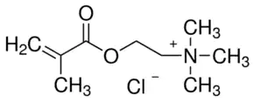
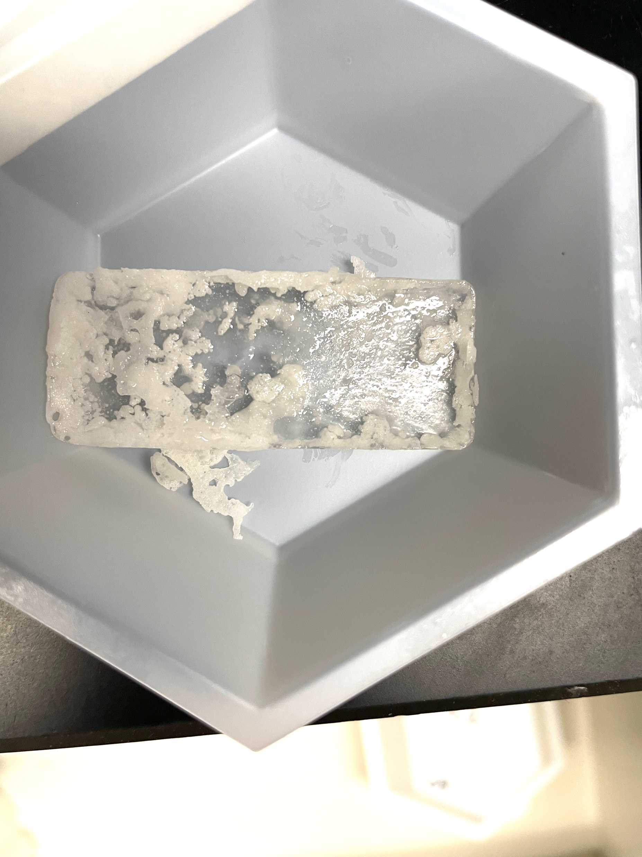
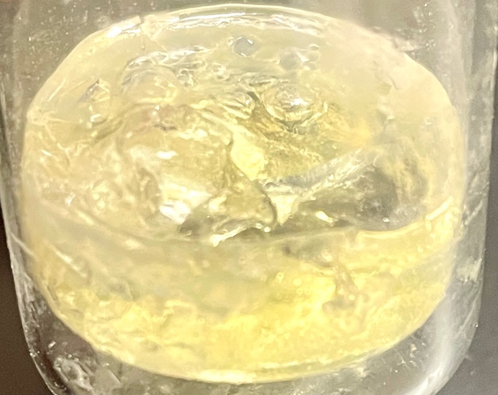

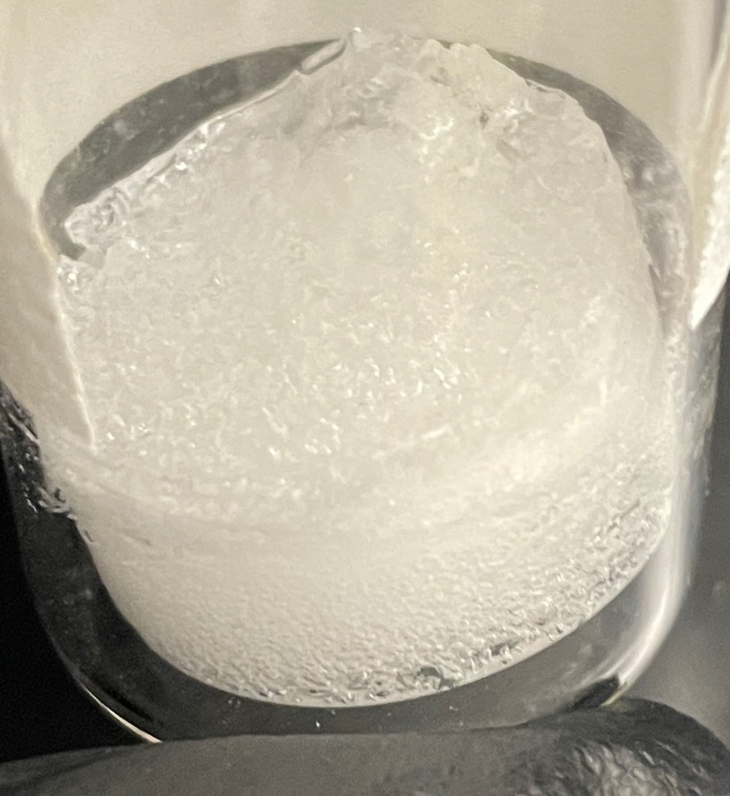
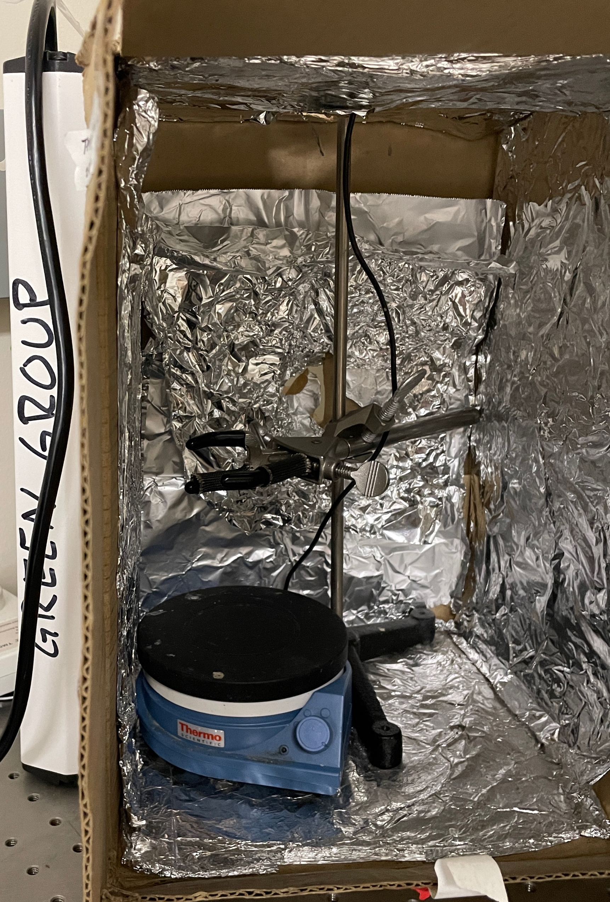
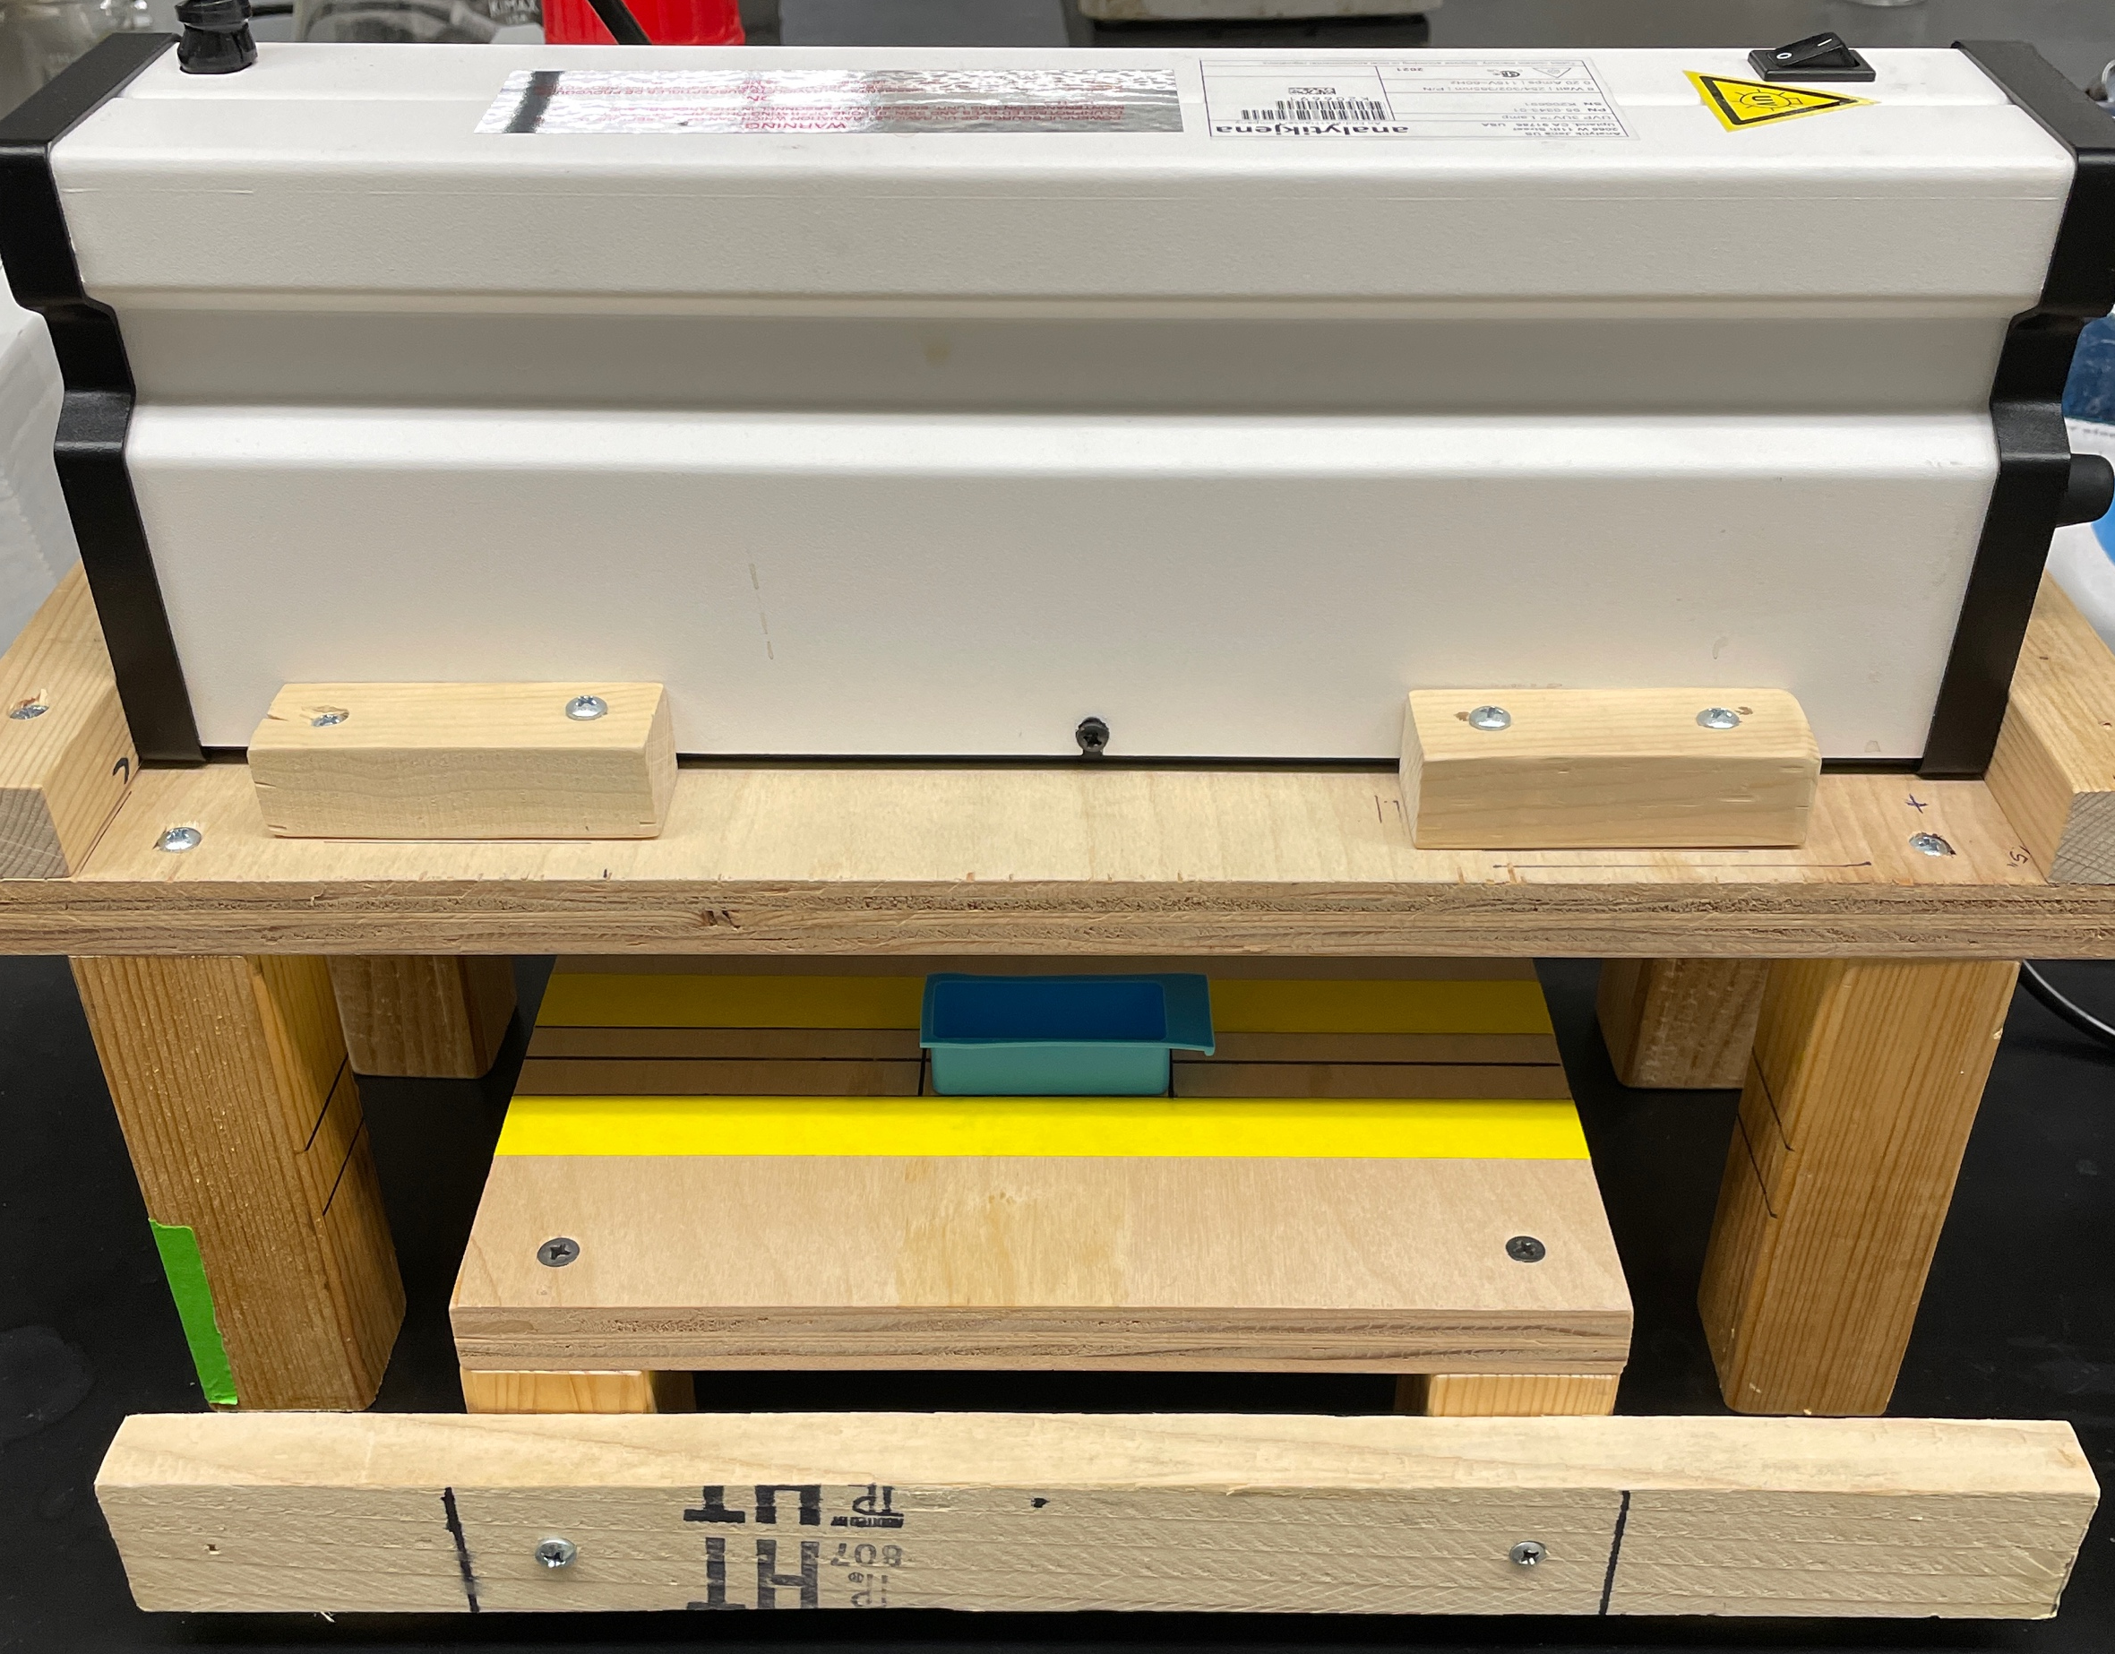
Synthesis & Results
Method 1: Expanding pre-cure
Dry unexpanded microspheres
Photopolymerization using DMPA initiator
Method 2: Expanding during cure
Dry unexpanded microspheres
Thermal polymerization using AIBN initiator
Method 3: Pre-expanded photopolymerization
Dry expanded microspheres
Photopolymerization using DMPA initiator
CO₂ capture monomer (TMAEMA-Cl⁻ ). Chloride exchanged with DAC functional counter-ion HCO₃⁻
Crosslinking monomer (PEGDMA)
Polymerization Method
Polymerization 1 (top image): UV box
Solution cured in a vial
Polymerization 2 (bottom image): UV platform
Solution cured in silicone mold
Polymerization 3: Oven
Solution cured in silicone mold
(w/ expanded spheres)
(Control, no spheres)

Slide 25
CO₂ Testing
DE microsphere-enhanced polymer (red) displayed fastest kinetics of uptake and highest adsorption
Polymers prepared through method 3 and using the platform for photopolymerization performed much better than those prepared through method 1 and using the vial.
Polymers prepared through method 3 and using the platform for photopolymerization had a much higher bicarbonate exchange percentage.
Sample | Synthesis Method | CO₂ Uptake at 20 Hours (µmol/g) | CO₂ Uptake Kinetics (first 5 hours) (µmol/g*hr⁻¹) | Bicarbonate Exchange (1 soak)
1% (w/w) DE Microspheres | method 3 + platform | 85.4 | 13.0 | 75.9%
Control | method 3 + platform | 57.3 | 6.6 | 75.9%
Control | method 1 + vial | 18.3 | 2.34 | 59.4%
1% (w/w) DU Microspheres | method 1 + vial | 13.2 | 1.1 | 50.0%

Slide 26
Accomplishments & Acknowledgements
Accomplishments
Used this project for my research essay and was nominated by ASU for the Barry Goldwater Scholarship for undergraduate researchers in STEM (winners announced last Friday in March!)
Recently presented a non-technical version of this research at the Grand Challenges Scholars Program National Annual Network Meeting (relating to the “develop carbon sequestration methods” grand challenge)
Accepted to present this research at the national Stanford Research Conference in early April
Used this project experience in carbon capture/air quality to obtain a position at the Pacific Northwest National Laboratory this upcoming summer (project on aerosol characterization)
Acknowledgements
Special thanks to Dr. Green, Ani, Kacie, and Husain for mentorship, advice, and equipment operation.

